Slide 1
Learning to Program in Python
Concept 4
Conditionals
(if statements)
Notes:
This lesson will focus on the IF statement. It is assumed that variables, data types, casting, and input-output have been covered before this lesson.
Conditionals are considered to be the first key Threshold Concepts in learning how to Program.
The tasks and ideas would require several classes to ensure students have time to engage with the concept.

Slide 2
Learning Intentions
From this lesson the students will:
Understand the concept of a conditional if statement.
Read and Write code to carry out simple tasks.
Use relational operators to make comparisons.
Notes:
The concept learned here, plus some of the programs written later in the lesson by the students, are used in the follow-up lesson on if..elif..else statements.
It will make a difference if any programs written here are saved with appropriate file names so they can be recalled in the follow-up lesson.
The main Learning Outcomes (LO) achieved are highlighted throughout the lesson and tasks.
The list is not exhaustive, and consultation with the LCCS spec is encouraged at all times throughout the implementation of the course.

Slide 3

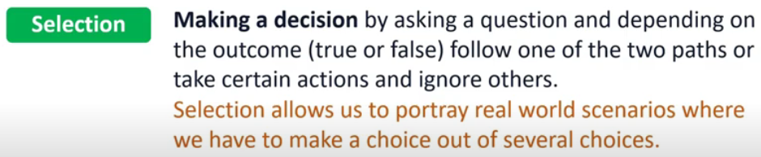
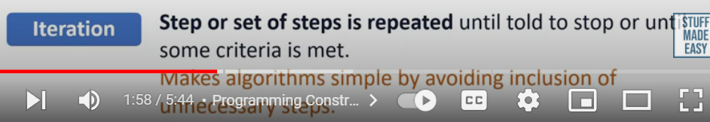
Python Control structures
Notes:
The concept learned here, plus some of the programs written later in the lesson by the students, are used in the follow-up lesson on if..elif..else statements.
It will make a difference if any programs written here are saved with appropriate file names so they can be recalled in the follow-up lesson.
The main Learning Outcomes (LO) achieved are highlighted throughout the lesson and tasks.
The list is not exhaustive, and consultation with the LCCS spec is encouraged at all times throughout the implementation of the course.

Slide 4
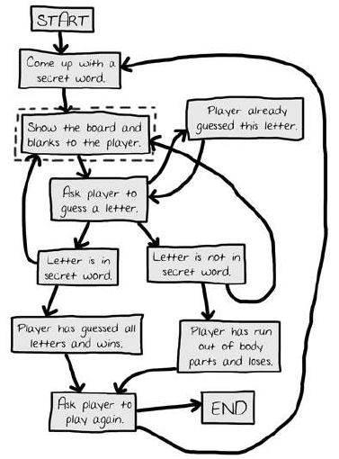
Hangman
Notes:
The concept learned here, plus some of the programs written later in the lesson by the students, are used in the follow-up lesson on if..elif..else statements.
It will make a difference if any programs written here are saved with appropriate file names so they can be recalled in the follow-up lesson.
The main Learning Outcomes (LO) achieved are highlighted throughout the lesson and tasks.
The list is not exhaustive, and consultation with the LCCS spec is encouraged at all times throughout the implementation of the course.

Slide 5

if Statement
if statement: executes a set of commands only if a certain condition is True.
Otherwise, the commands are skipped.
  Syntax:
indentation
Notes:
The If statement is read as “If the temperature is greater than zero is True then execute the following commands”
Note the indentation.

Slide 6
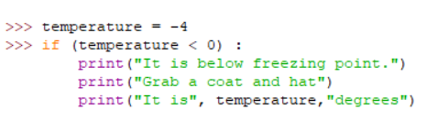
if Statement
You can execute as many lines of code within an if statement as you wish.
Notes:
Note that all lines within the If statement are indented. These will all be executed when the condition is True.

Slide 7
if Statement
if (condition is True):
  Execute these set of commands
Otherwise the commands are skipped.
  Syntax
  if condition:
  execute statements (note indentation)
Notes:
A flow chart of the If statement follows

Slide 8
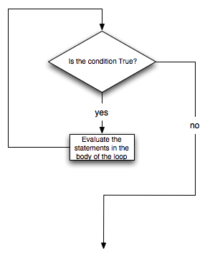
if flowchart
Flow Chart starts here
Execute these lines
Execute your code
Continue
Notes:
A FLOW chart representation ….

Slide 9
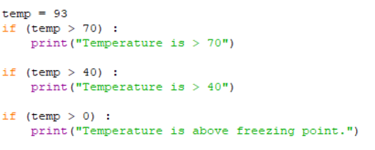
Multiple if statements
Can you predict what the output will be ?
LO 1.22 students should be able to read, write, test, and modify computer programs
Notes:
Encourage students to make a prediction before testing out the code.
The purpose of this exercise is to highlight that the interpreter will continue executing If statements whether the previous ones were True Or False.
The PRIMM method will encourage engagement. (Predict Run Investigate Modify Make)

Slide 10
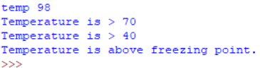
output from Multiple if program
All three if statements were true so all three commands are executed.
LO 1.4 students should be able to solve problems using skills of logic
Notes:
The output from program with multiple If statements.

Slide 11
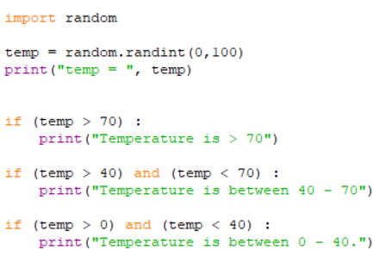
Testing 2 conditions in 1 if
Read this code.
Especially the and operator.
Predict what happens.
3 temperatures will slip through?
One of them is 40.
Notes:
Encourage students to make a prediction before testing out the code.
There are three temperatures that will produce no output (0, 40 and 70).
Pose the question as a brain teaser. (It is mentioned on the slide.)

Slide 12
Fill in the Operation and Answer columns for each comparison
- Describe the operation in your own words-
Relational Operator | True / False | Operation | Answer (True/False)
== | 1 + 1 == 2 | equals | True
!= | 3.2 != 2.5 | does not equal | True
< | 10 < 5 | less than | False
> | 10 > 5 | greater than | True
<= | 24 <= 13 | less than or equal to | False
>= | 5.0 >= 5.0 | greater than or equal to | True
Notes:
Encourage the students to use their IDE to figure out and understand the less familiar operations.
Draw attention to the “equals” relational operator. Ask why there are two equals. (One equal sign is an assignment!!)
The etasksheet above can be downloaded from the website, completed by the students (as a fillable pdf) and stored in their online space. Or it can be printed out for a written class task.
The answers are revealed when the slide show is run.

Slide 13

Comparing User Inputs
Write a program that compares two numbers entered by the user.
If the numbers are different, tell the user which number is greater.
If the numbers are equal, tell the user the numbers are equal.
Before you begin, some reminders…….
LO 1.1 students should be able to describe a systematic process for solving problems and making decisions
Notes:
Ask the students what the reminders might be ….. In particular casting inputs from strings to integers

Slide 14
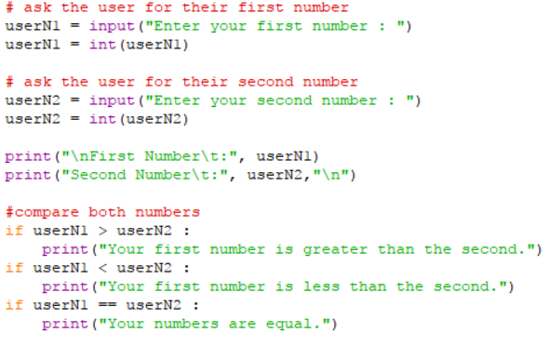
Reminders on User Inputs
Python takes all input as STRINGS.
You must CAST the input to the DATA TYPE you want.
The example below casts the user input from a string to an integer.
Notes:
Before showing the sample code on the next slide, give the students some time to write the algorithm / program to compare two numbers entered by the user.

Slide 15
Comparing User Inputs .. sample code
What code might be behind me?
Notes:
Sample Code for comparing two numbers entered by the user.
This will be used as one of the kick off points for introducing if..then..else statements

Slide 16

Create Your Own … Guessing Game
Your task is to write a program that asks the user to guess a number between 1 and 5 that your program randomly generates.
You must write the algorithm first and then code it in Python.
User Interface
You must tell the user if they guessed correctly and congratulate them.
If they guessed incorrectly, you must tell them if their guess was too high or too low. And let them have 1 more go. If they are wrong, then say Hard Luck!!!!
LO 1.16 students should be able to compare two different user interfaces and identify different design decisions that shape the user experience
Notes:
This is the bones of the guessing game. At this point, students can only control the flow of their programs using If statements.
Students must write the algorithm first. The next slide shows a possible algorithm in pseudo-code.
On ncca.ie, use the html resource to write the guessing game in Scratch and analyse its CT level. Compare the 2 programs and the 2 User Interfaces.
When students study LOOPS they will be able to offer the user unlimited amount of turns and the option to exit the program.

Slide 17
pseudo code .. for guessing game
generate a random number between 1 and 5;
userNumber = user’s first guess;
if userNumber == gameNumber { print congratulations; }
if userNumber > gameNumber { print your guess is too high; }
if userNumber < gameNumber { print your guess is too low; }
if userNumber != gameNumber {
userNumber = user’s second guess;
if userNumber == gameNumber {
print congratulations; }
if userNumber != gameNumber {
print Hard Luck; }
}
NESTED if statements
LO 2.5 students should be able to use pseudo code to outline the functionality of an algorithm
Notes:
Students finding it hard to write the algorithm/program unaided could use this pseudo code as a scaffold for writing their own code.
The algorithm must introduce the concept of NESTED if statements … that is if statements within if statements.

Slide 18
Lesson Review
As a result of this lesson I am able to:
Understand the concept of a conditional if.
Read and Write code to carry out simple tasks.
Use relational operators to make comparisons.
Notes:
The main Learning Outcomes (LO) achieved are highlighted throughout the lesson and tasks.
The list is not exhaustive, and consultation with the LCCS spec is encouraged at all times throughout the implementation of the course.

